Slide 1
Amici dei Popoli Padova: Who are we?
Amici dei Popoli Padova was founded in 1983 as a local section of Amici dei Popoli NGO, based in Bologna which is an association engaged in international volunteering.
We are a group of people who want to overcome prejudice, prevent discrimination and fight social inequalities through local, concrete actions.
We are located in «Arcella», a neighbourhood of Padova where foreign residents make up 31,78% (2019) of the population. We promote intercultural values and activities to fulfill the needs of our community.

Slide 2
Amici dei Popoli Padova: What do we do?
EXTRA-CURRICULAR ACTIVITIES:
Supporting foreign children’s integration, Italian language fluency, educational attainment levels and self esteem by offering help with homework, socialization and mentoring.
WITH SCHOOLS:
Courses of global citizenship education;
Digital education and tackling hate speech courses;
Courses promoting gender equality
FOR VOLUNTEERS:
Training courses on global dynamics and intercultural education (Percorso di Formazione alla Mondialità & Strumenti per l’intercultura);
National and Regional Civil Service (in Italy and abroad)
DEVELOPMENT COOPERATION:
Supporting development projects in the Africa and Latin America.

Slide 3
Amici dei Popoli Padova Projects: Made in digital
A project funded by Regione Veneto to complement their educational offer in secondary schools.
SDG’s: Made in digital will teach how new digital technologies can support the achievement of Sustainable Development Goals (SDG’s) related to migration, gender equality, tackling hate-speech and climate change.
Technologies & Training: students will learn to find information, think critically while using technology and express their creativity. The project will train teachers in using new tech skills and allow them to use technology more independently. https://www.amicideipopolipadova.it/attivita/educazione-allo-sviluppo/made-in-digital-lagenda-2030-nellera-delle-nuove-tecnologie/
RESULTS:
9 SCHOOLS (2019/2020)
…work in progress!

Slide 4
Amici dei Popoli Padova Projects: Start the Change!
A Amici dei Popoli NGO project, co-funded by the European Commission. It aims to raise European citizens’ awareness of the importance of a joint effort to contribute to ending poverty, protecting the planet and ensuring peace and prosperity for all, as stated in the Sustainable Development Goals.
Education: Start the Change! proposes a replicable educational model to increase the engagement of students and young people within their communities. The project aims to strengthen networks among schools, organizations and local authorities.
Citizenship: The proposed “citizenship paths” invite young people aged 15 to 24 to explore the reality in which they live and reflect on the relationship between migration and global inequality.
https://www.startthechange.eu/
RESULTS:
10 SCHOOLS
226 STUDENTS

Slide 5
Amici dei Popoli Padova Projects: Generiamo Una Nuova Italia
RESULTS:
6 SCHOOLS
144 STUDENTS
A F.O.C.S.I.V. project, funded by the Italian Ministry of Labour and Social Policies.
Integration & Hospitality: the project aims to promote equality, justice and an inclusive society. It will empower young second generation migrants by increasing cooperation between schools, local institutions and potential future employers.
Network: Development of the cooperation between civil society organizations offering services for migrants. This should lead to more hospitality, integration, volunteering and international solidarity.
http://generiamounanuovaitalia.it/

Slide 6
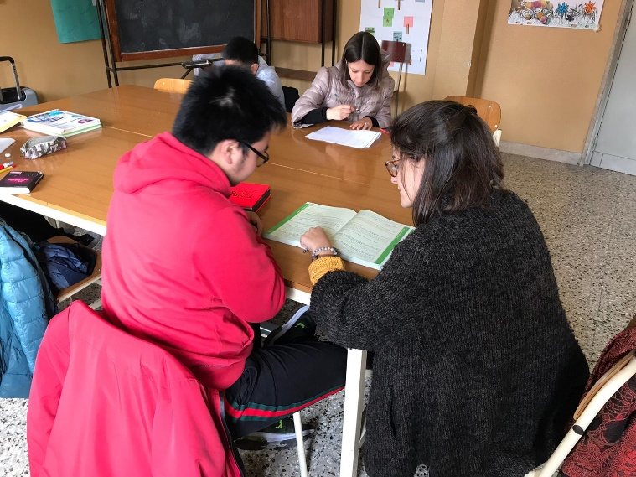
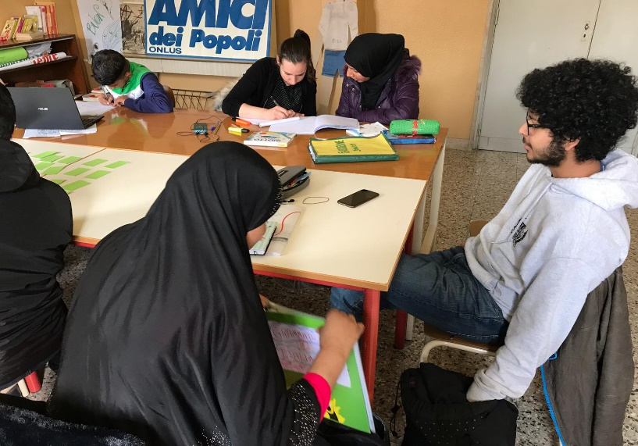
2 - Local Activities
Italian language courses for adult women (Basic level: A1- A2)
Italian language courses for children

Slide 7
Italian Language Courses 3 important elements:
Women
Adults
Migrants

Slide 8
Gender
A lot of these students have been living in Italy for a long time, sometimes years. These years are often spent in isolation: while their husbands and children integrate through their job or schooling, women tend to subordinate their needs to those of the family.
It is important for the class space to be a completely female space, a sort of time for themselves where to network with other women.
“In these 2 hours of italian course, all problems and difficulties go away!” A.
In this female space it is possible to deal with specific topics, such as body, maternity, family relationships, etc., all subjects which would be difficult to discuss with a male presence.

Slide 9
Adults
Adult students are goal-oriented and know what they want or don’t want to learn.
Adult learning is concrete and functional in daily life and comes from concrete needs, leading to strong personal motivation.
It’s important to adapt to students’ needs
The desire to learn Italian is also connected to the will to reclaim their parental role by being able to support their kids with homework

Slide 10
Migrants
In the same class we can have people coming from a lot of different countries such as Senegal, Togo, Nigeria, Morocco, Algeria, Afghanistan, Bangladesh, Macedonia, Albania, Syria, Vietnam, etc.
That means multiethnic and multilingual classes
Different cultural background, different concept of time and different way to act
The goal is to transform this into a space of inclusion

Slide 11
Our classes:
During the morning
2 times a week
In presence or on-line
Nursery service

Slide 12
Methods and instruments:
Interactive lessons
Real-life examples
Role play
Start with what students like
Use body and hands to learn
Exchange of experiences between students and teacher
Give space and value to all students and cultures
Field trips

Slide 13
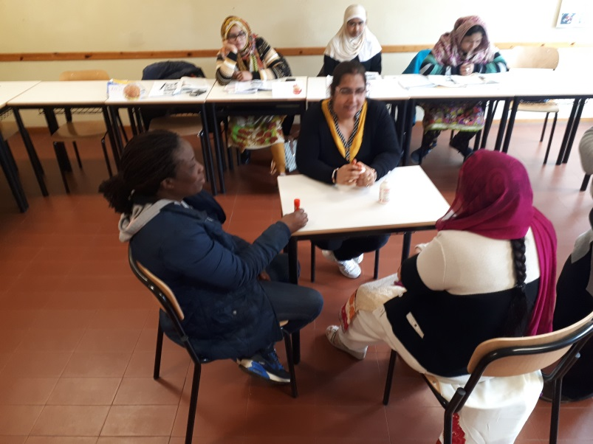
Partecipative classes

Slide 14
Goals
Basic language learning
Facilitating the relation between mothers and school services
Creating a network between women which they can rely on outside of class
Supporting students in getting to know the territorial context, services and opportunities for foreign residents

Slide 15
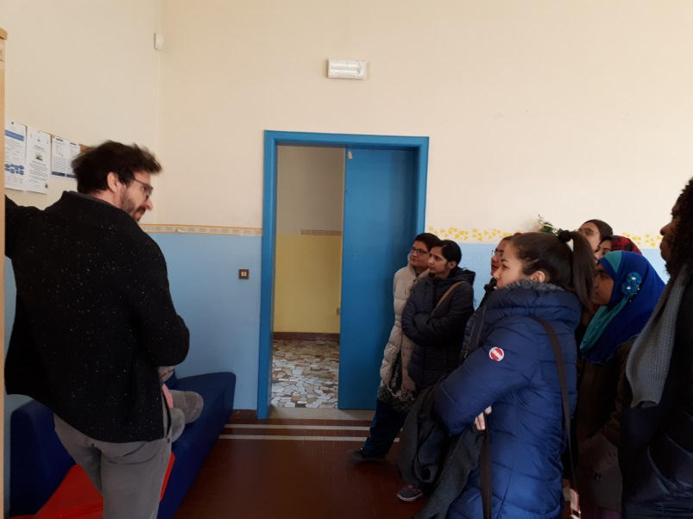
Field trips..

Slide 16
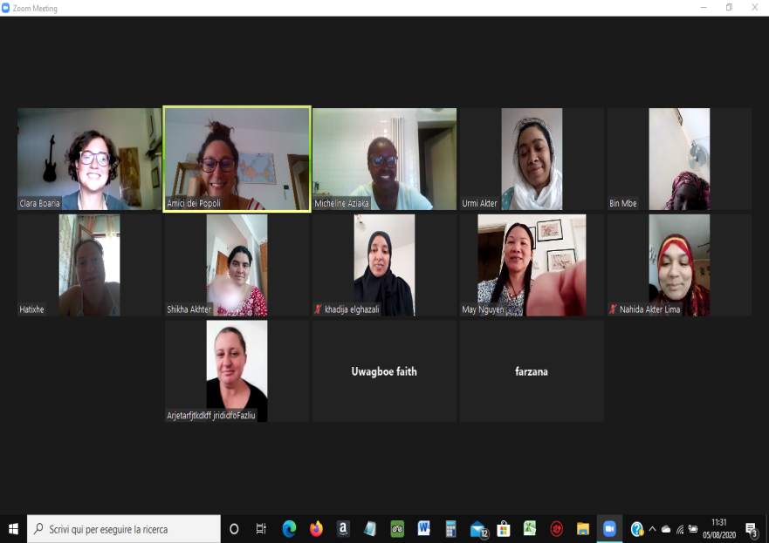
Create a team..

Slide 17
Italian language courses for children
We create a space for foreign children to learn Italian to support their integration in school and outside.
We offer this course for primary and middle school students.
Classes take place outside of normal school hours, either on school premises or in other spaces (e.g. the local Parish)
We help kids during the entire school year

Slide 18
Italian language courses for children- online
During the pandemic, activities have been adapted to remote learning
Children have been supported through different online instruments (Platforms, calls, digital App)
Children continued to do their homework, with the support of our volunteers

Slide 19
Network
We have a strong connection with schools and families in our neighborhood. Potential students are usually identified by their teachers.
Our dedicated volunteeers do very important work. They are specifically trained to work with foreign children.

Slide 20
Methodologies
Playful learning
Mentoring ( mentor and mentee)
Peer education
Cooperative learning
Non-judgmental educational environment

Slide 21
Goals
Learning Italian in friendly atmosphere
Bonding between children
Connecting schools, families and the local community
Promoting intercultural topics and involving citizens in local actions

